Slide 1
Three Tier Web Application using Docker and Kubernetes

Slide 2
What is three tier
It’s actually a division of your system in 3 parts
1.Presentation Layer (Tier 1): What you you see when you open your website is called the presentation layer basically it is the layer that users interact directly
2.Logical Layer (Tier 2): Imagine this layer as the brain behind the scenes. It takes the information you provide through the user interface and processes it according to the rules of the system. If it’s a shopping website, for instance, this layer figures out things like the total price of your items, applies discounts, and checks if everything is in stock
3.Data Layer (Tier 3): This is where the data is stored and retrieved. It’s like the memory of the system.Data could be stored in databases, files, or any other data storage systems.The data layer is responsible for managing and storing information that the system needs.

Slide 3
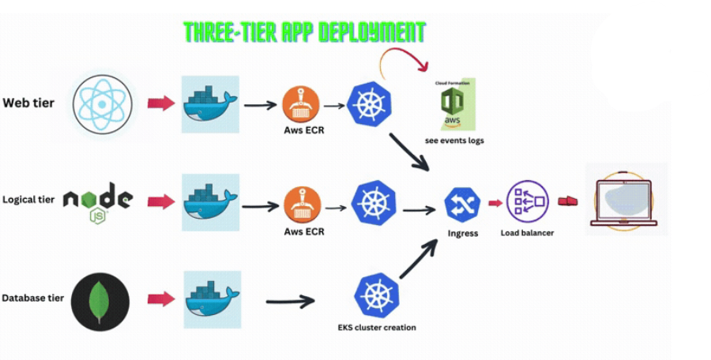
Flow Diagram

Slide 4
Three Tier Web application
Docker
Kubernetes
Docker is an open-source platform that provides a way to automate the deployment of applications inside lightweight, portable containers. These containers encapsulate an application’s code, along with all the necessary dependencies such as libraries and system tools, allowing the application to run consistently across different computing environments.
Docker containers are isolated from each other and the host system, ensuring that they do not interfere with one other and that the application runs the same regardless of where it is deployed. The key benefits of using Docker include portability, efficiency, and scalability
Kubernetes (K8s) is an open-source platform that manages Docker containers in the form of a cluster. It serves as a powerful container orchestration tool, automating various aspects of container deployment, scaling, and management. Developed by Google and later donated to the Cloud Native Computing Foundation (CNCF), Kubernetes has gained widespread adoption due to its robust features and community support.
Kubernetes plays a crucial role in modern cloud infrastructure, providing a flexible and efficient way to manage containerized workloads at scale.

Slide 5
Deploying the three Tier web application using docker
To configure OpenStack with docker and deploy a 3 tier application.
Build docker containers for the database and web-server of the application which ensures independence from underlying architecture.
The application finally deployed on the Openstack VM.
Technologies that can be used are docker, MySQl , Apache ,openstack.
In this we are deploying the application on openstack

Slide 6
Why Docker?
Docker allows you to package an application with all of its dependencies into a standardized unitfor software development.
Docker containers wrap up a piece of software in a complete filesystem that contains everything it needs to run: code, runtime, system tools, system libraries - anything you can install on aserver.
This guarantees that it will always run the same, regardless of the environment it is running in.
Containers have similar resource isolation and allocation benefits as virtual machines but adifferent architectural approach allows them to be much more portable and efficient.

Slide 7
What is meant by open stack
OpenStack is a free and open-source software platform for cloud-computing, mostly deployed as an infrastructure-as-a-service (laaS).
The software platform consists of interrelated components that control hardware pools of processing, storage, and networking resources throughout a data center.
Users either manage it through a web-based dashboard, through command-line tools, or through a RESTful API.
It provides a set of software tools for building and managing cloud computing platforms for public and private clouds.
The platform consists of interrelated components that control hardware pools of processing, storage, and networking resources across a data center.
It is the one of the open source platform in which we can deploy a three tier web application using docker.

Slide 8
Approach
Deploying a three-tier web application using Docker on OpenStack involves several steps that leverage the capabilities of both Docker for containerization and OpenStack for cloud infrastructure management. Here’s a high-level approach:
Containerize Each Tier: Begin by creating Docker images for each tier of your application - the presentation layer (frontend), the application layer (backend), and the data layer (database). Each image will contain the necessary code and dependencies for that tier to run independently.
Compose with Docker Compose: Use Docker Compose to define and run multi-container Docker applications. With a docker-compose.yml file, you can configure your application’s services, networks, and volumes.
Deploy on OpenStack: Once your Docker images and compose file are ready, you can deploy them on OpenStack. You’ll need to create virtual machines or instances within OpenStack that will host your Docker containers. You can use OpenStack’s orchestration service, Heat, to automate the deployment of resources and Docker containers.
Networking and Security: Configure OpenStack networking to ensure that your application components can communicate with each other. Set up security groups and rules to control access to the instances and services.
Scaling and Management: Utilize OpenStack’s capabilities to scale your application dynamically. Monitor the performance and health of your application using OpenStack’s telemetry services.

Slide 9
Three tier application deployment on Kubernetes
To Deploy an application using Kubernets mainly they are 5 phases:
Phase 1 →Setup base EC2 , IAM user and Basic tools on EC2
Phase 2 →Built frontend and backend images
Phase 3 → Kubernetes
Phase 4 →Setup Application Load balancer and ingress
Phase 5 →Destroy Everything
Phase1: Setup base EC2 , IAM user and Basic tools on EC2
Create an IAM User and launch an EC2 Instance.
Setup aws cli ,docker ,kubectl and eksctl
To install AWS CLI - snap install aws-cli –classic and configure it.
Install the docker and setup it – Sudo apt install docker
Setup Kubectl - snap install kubectl –classic
Install the eksctl

Slide 10
Phase 2: Built frontend and backend images
1.Setup Elastic Container Registry (ECR)
Go to AWS Management Console and navigate to the Amazon ECR service.
Click on "Create repository" for frontend and backend separately.
Set the repository name and configure repository settings (e.g., set visibility to public).
2.Setup Frontend
Navigate to the frontend directory in the project: cd frontend.
Run the following commands to build and push the frontend image to ECR:
aws ecr-public get-login-password --region us-east-1 | docker login --username AWS --password-stdin public.ecr.aws/l0l7e4u1
docker build -t 3-tier-frontend .
docker tag 3-tier-frontend:latest public.ecr.aws/l0l7e4u1/3-tier-frontend:latest
docker push public.ecr.aws/l0l7e4u1/3-tier-frontend:latest

Slide 11
Setup Backend
Navigate to the backend directory in the project: cd ../backend.
Run the following commands to build and push the backend image to ECR (replace ECR repository URL and image name as needed):
aws ecr-public get-login-password --region us-east-1 | docker login --username AWS --password-stdin public.ecr.aws/l0l7e4u1
docker build -t 3-tier-backend .
docker tag 3-tier-backend:latest public.ecr.aws/l0l7e4u1/3-tier-backend:latest
docker push public.ecr.aws/l0l7e4u1/3-tier-backend:latest

Slide 12
Phase 3 :Kubernetes Setup
1.Create an EKS Cluster
Run the following command to create an EKS cluster:
eksctl create cluster --name three-tier-cluster --region us-east-1 --node-type t2.medium --nodes-min 2 --nodes-max 2
aws eks update-kubeconfig --region us-east-1 --name three-tier-cluster
2.Create a Namespace
Run the following command to create a namespace for the project:
kubectl create namespace workshop
kubectl config set-context --current --namespace workshop
3.Deploy Frontend and Backend
Apply the deployment and service manifests for frontend and backend:
kubectl apply -f k8s_manifests/frontend-deployment.yaml
kubectl apply -f k8s_manifests/frontend-service.yaml
kubectl apply -f k8s_manifests/backend-deployment.yaml
kubectl apply -f k8s_manifests/backend-service.yaml

Slide 13
Phase 4: Setup Application Load balancer and ingress
1.Install AWS Load Balancer Controller
Run the following commands to install the AWS Load Balancer Controller using Helm:
sudo snap install helm --classic
helm repo add eks https://aws.github.io/eks-charts
helm repo update
helm install aws-load-balancer-controller eks/aws-load-balancer-controller -n kube-system --set clusterName=three-tier-cluster --set serviceAccount.create=false --set serviceAccount.name=aws-load-balancer-controller
Verify the deployment:
kubectl get deployment -n kube-system aws-load-balancer-controller
2.Setup Ingress
Apply the Ingress manifest for internal routing between the three tiers:
kubectl apply -f k8s_manifests/full_stack_lb.yaml
kubectl get ing -n workshop
Access the application through the Ingress DNS address in a web browser.

Slide 14
Phase 5: Destroy Everything
Clean Up
Delete all resources created during the project:
kubectl delete -f .
eksctl delete cluster --name three-tier-cluster --region us-east-1
aws cloudformation delete-stack --stack-name eksctl-three-tier-cluster-cluster
Verify
Check the AWS CloudFormation console for the status of the stack deletion.

Slide 15
Thank You
Team 5 :
B V N Rahul (RA2111028010192)
D ObulReddy (RA2111028010137)
D Manjunath Reddy (RA2111028010140)
G Prabhas Reddy (RA2111028010188)

